Slide 1

Week #1
AI Academy®
1
Day 1:
Course Introduction
Encourage or Motivation Lecture
Market Job Opportunities
Course Applications
Reviews & Feedbacks

Slide 2
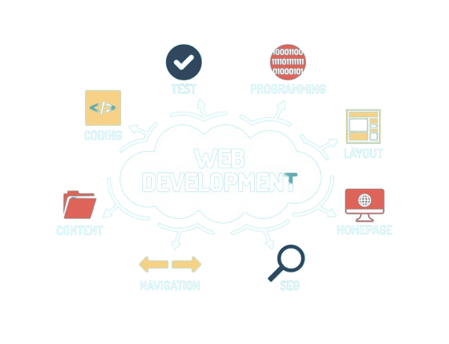
Week #1
AI Academy®
2

Slide 3

Week #1
AI Academy®
3

Slide 4

Week #1
AI Academy®
4

Slide 5
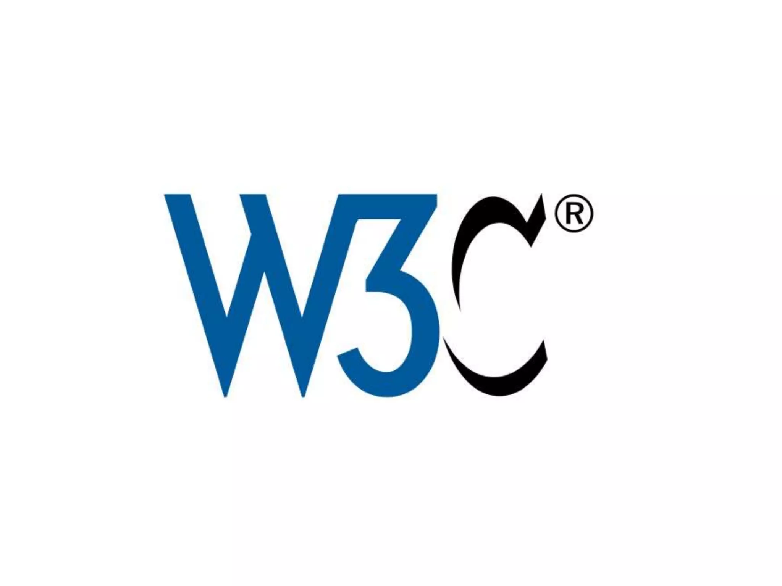
Week #1
AI Academy®
5

Slide 6
Week #1
AI Academy®
6
Day 2:
Introduction to World Wide Web(WWW)
Website
Web Pages
Types of Websites
Reviews & Feedbacks

Slide 7

Week #1
AI Academy®
7
World Wide Web Often Called is “Web”.
“Network” Of Computers all over World.
To Communicate with “EACH” Other.
“URL” and “HTML”.
Use “HTTP” to Communicate
Web and Web 2.0

Slide 8

Week #1
AI Academy®
8

Slide 9

Week #1
AI Academy®
9

Slide 10
Week #1
AI Academy®
10
Day 3:
Architecture
Difference between Static & Dynamic Web pages
Comparison
Reviews & Feedbacks

Slide 11
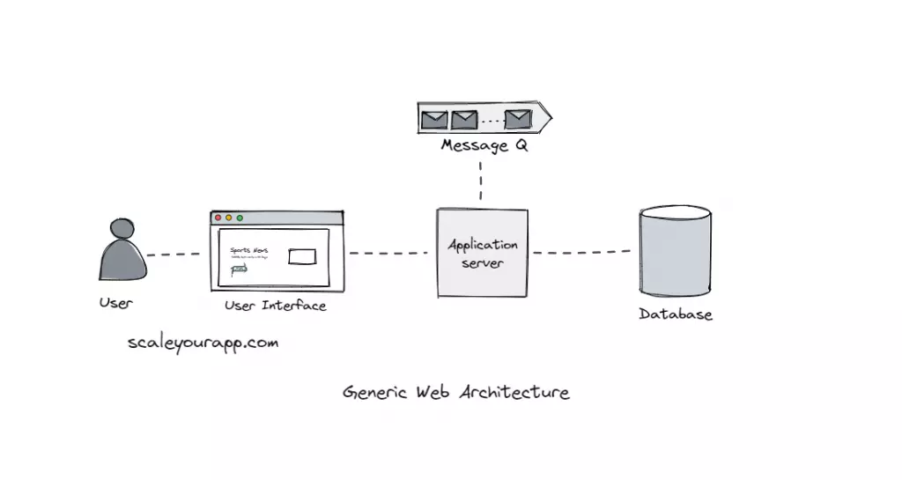
Week #1
AI Academy®
11

Slide 12
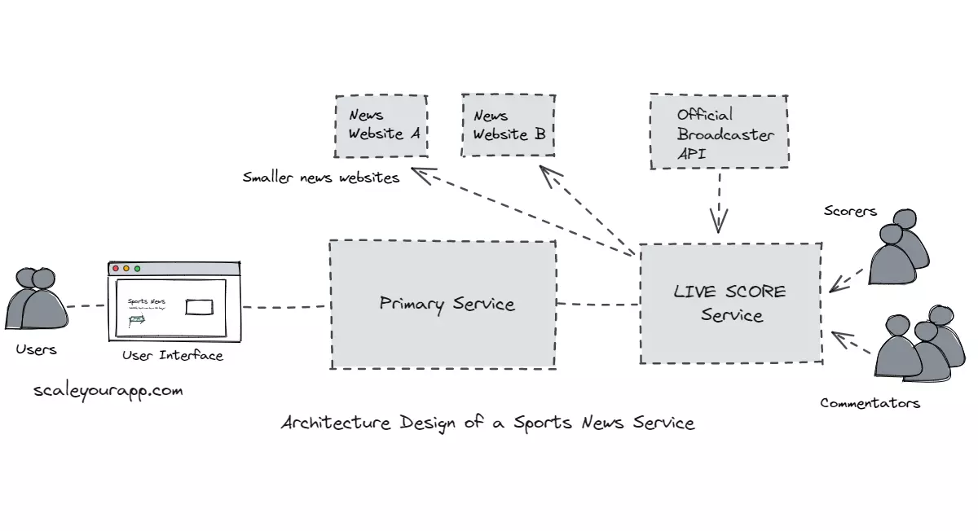
Week #1
AI Academy®
12

Slide 13
Week #1
AI Academy®
13
Day 4:
Difference Between Frontend & Backend
Install Chrome
Install VS Code Editor
What is HTML? Building Blocks?
HTML Structure (Headings, Paragraphs)
Reviews & Feedbacks

Slide 14

Week #1
AI Academy®
Needed Applications:
14

Slide 15
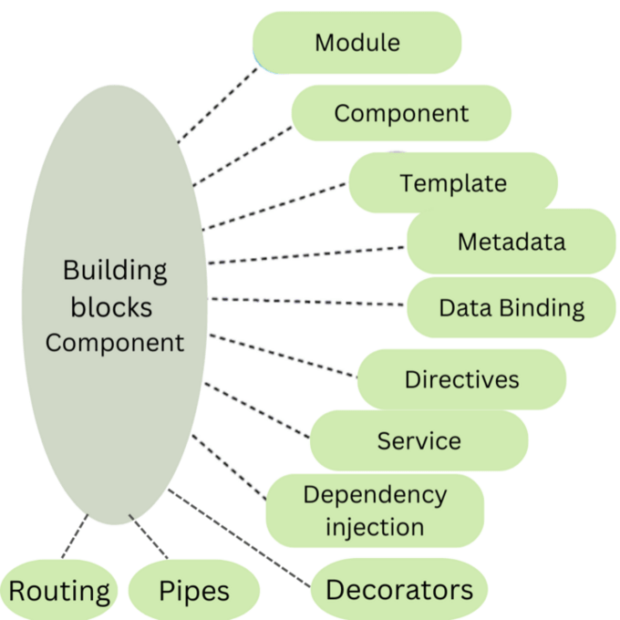
Week #1
AI Academy®
15

Slide 16
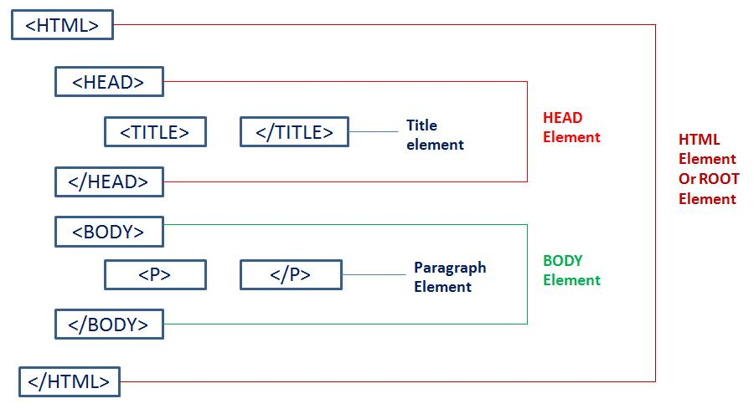
Week #1
AI Academy®
HTML Structure:
16

Slide 17
Week #1
AI Academy®
17
Day 5:
HTML Formatting
HTML Attributes
Attributes Types
Reviews & Feedbacks

Slide 18
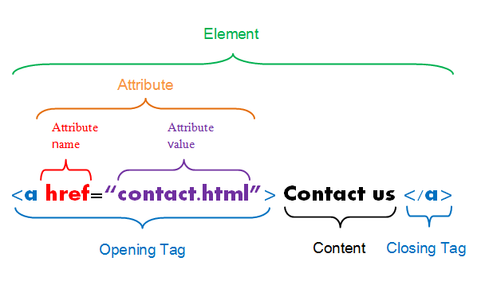
Week #1
AI Academy®
HTML Attribute:
18

Slide 19
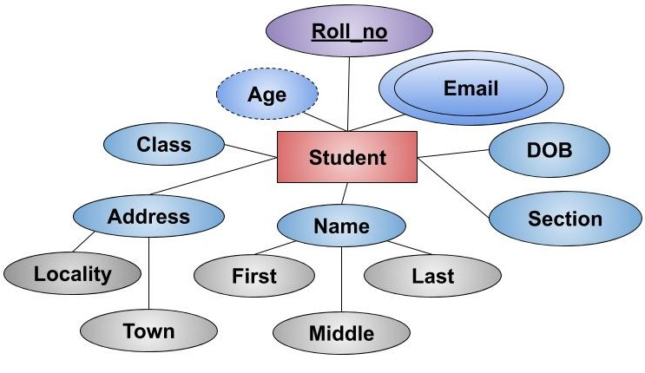
Week #1
AI Academy®
HTML Identifier:
19

Slide 20

Week #1
AI Academy®
20

